Slide 1

Postman API Client
Simple API Testing

Slide 2
Other Tools -> The Road to Postman
SoapUI
Kludgy UI
Really want you to use paid add-ons
Difficult to add custom headers
Didn’t figure out parameters based on other calls - pretty sure it can be done, though.
Easy to muck up endpoints

Slide 3
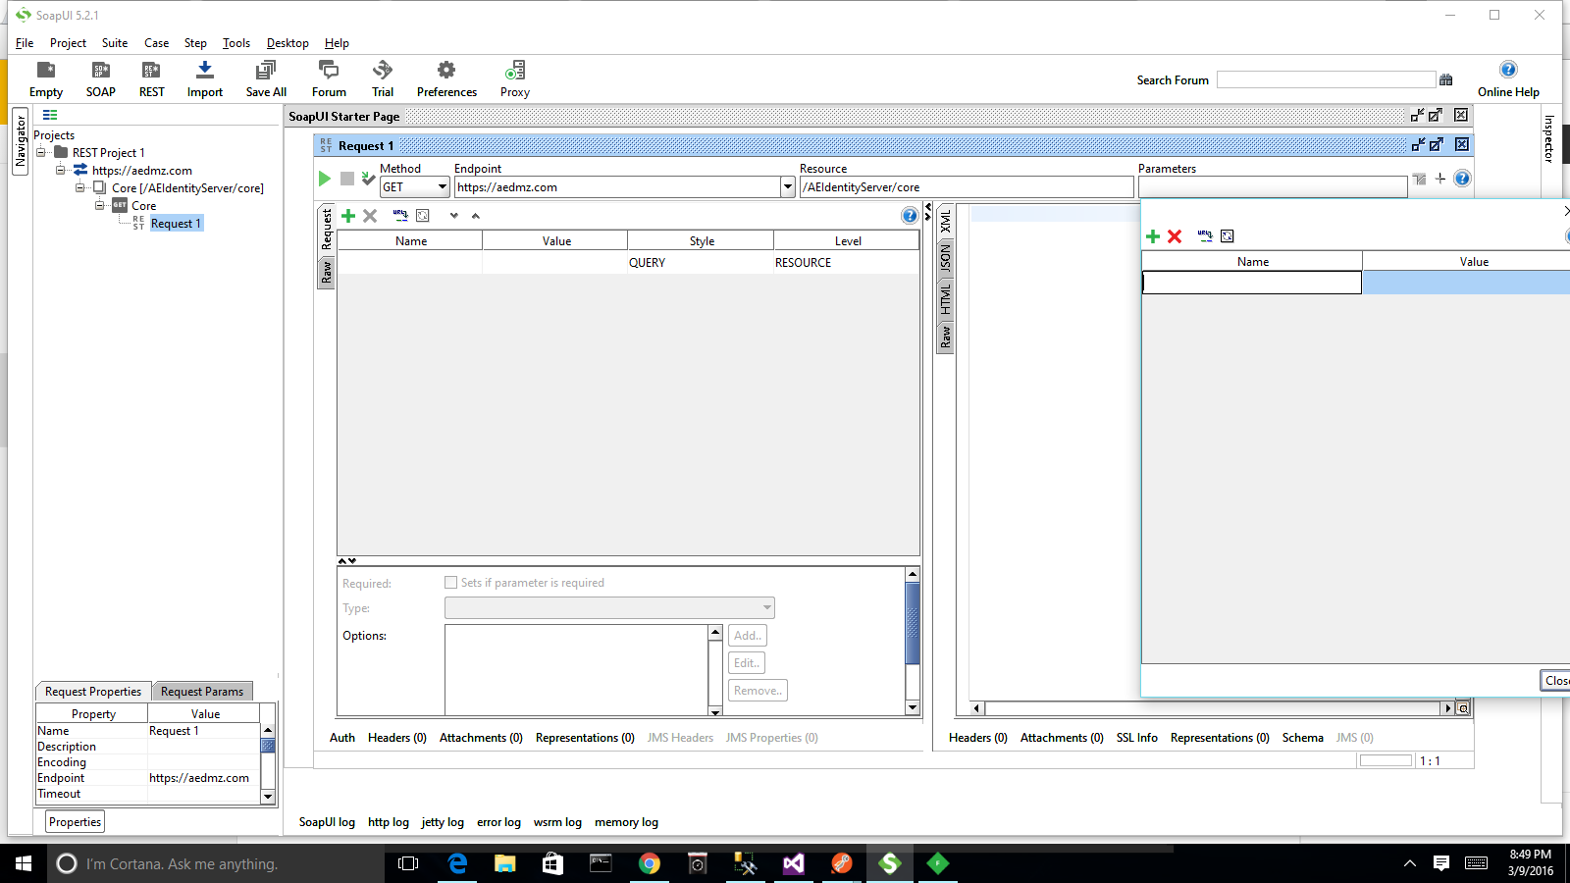

Slide 4
Other Tools -> The Road to Postman
Fiddler
Very nice for crafting single requests and seeing the response
Good for testing API clients because you can see the request traffic
Not good for seeing async httpClient calls (may be some config setting that I don’t know about)
Can replay requests, and AutoResponder seems cool, but didn’t work well for building a test suite

Slide 5
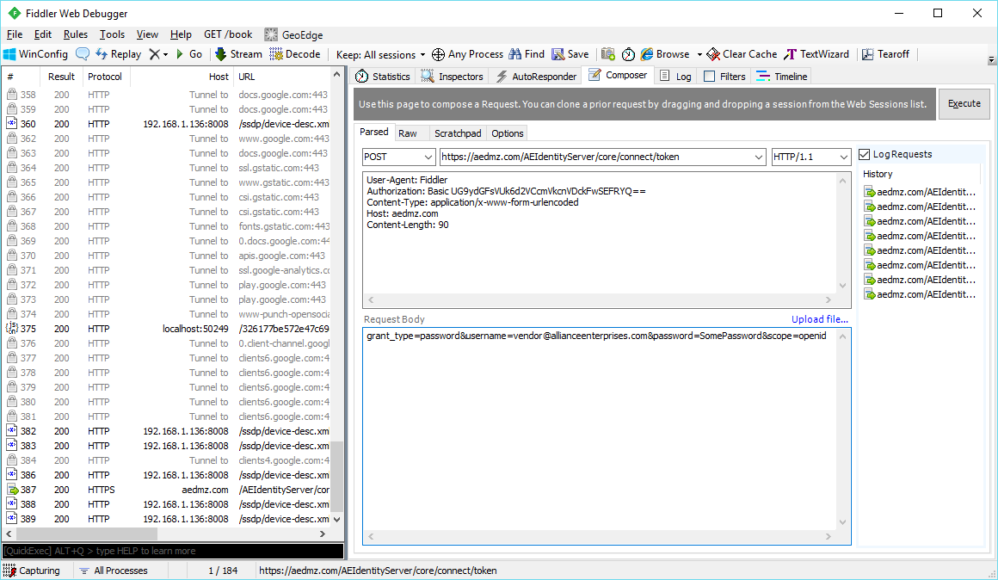

Slide 6
This Tool -> Postman REST Client
Chrome Plugin
Quick to set up, not a steep learning curve

Slide 7
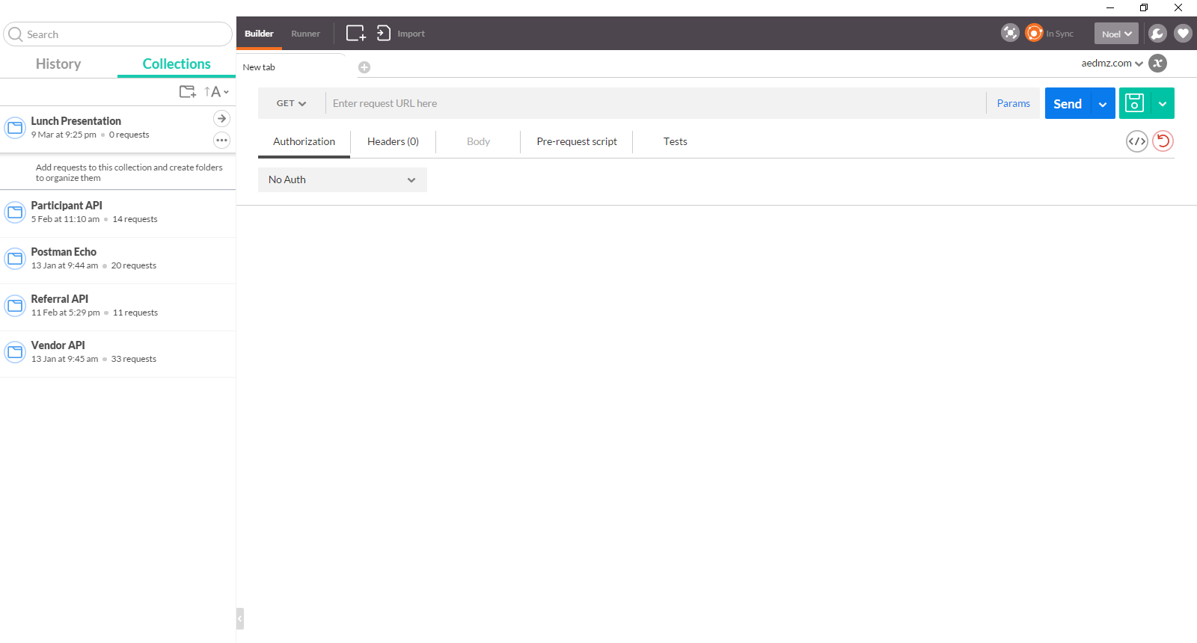
Demo/Overview

Slide 8
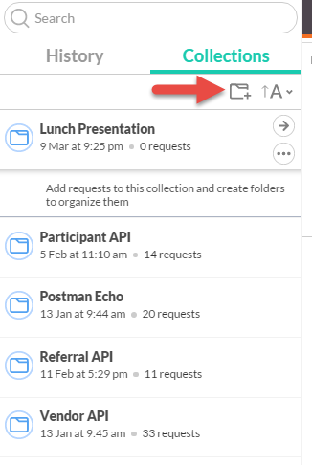
Collections
Click the folder Icon to create a collection

Slide 9
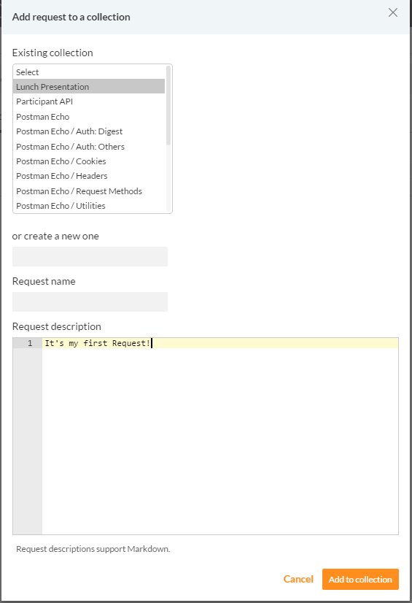
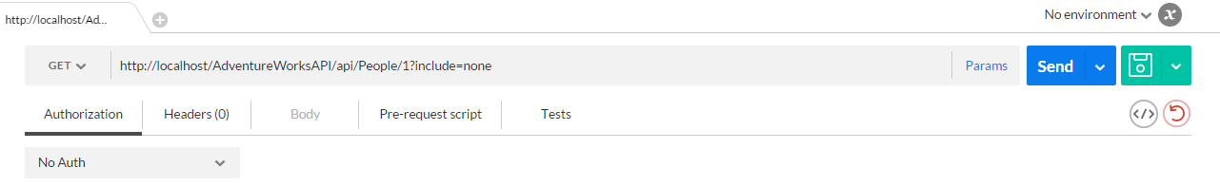
Requests
Type in the url, select the http method, click Send to test, then save it in your collection.

Slide 10
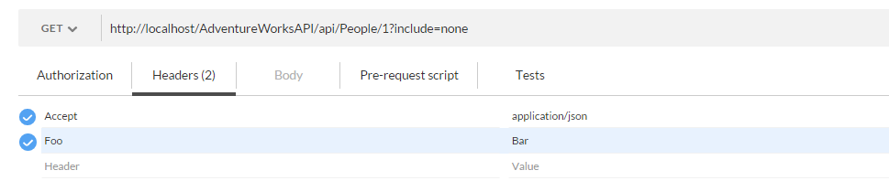
Requests - Headers
Click in the empty space and start typing a header. You can add custom headers or it has autocomplete.
Video Link: https://drive.google.com/open?id=0B9rIgG9pCUEbSU55RWhiTUxIdTg
Unfortunately, it needs to be a youtube video to embed it in a slide. Boo. No more of those.

Slide 11
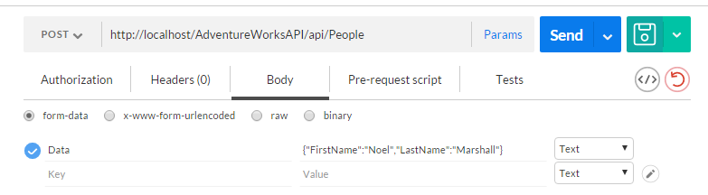
Requests - Body
Below is an example of multipart form data

Slide 12
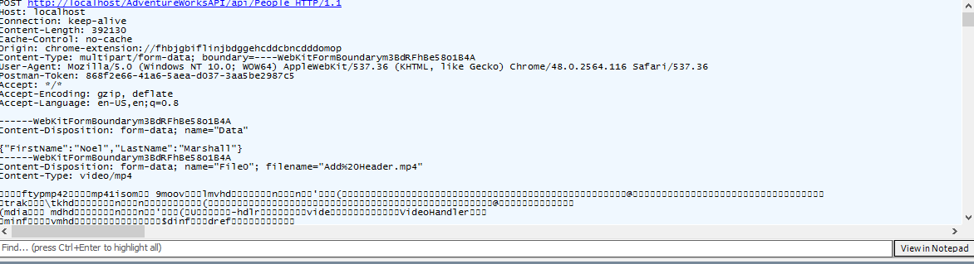
Requests - Body
Request in Fiddler

Slide 13
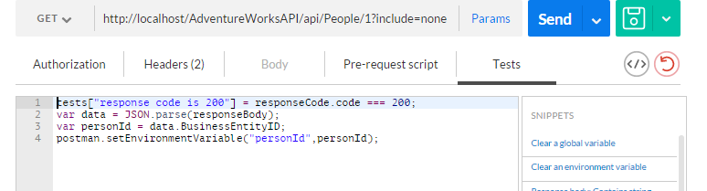
Requests - Tests
Tests are just javascript with some built in functions

Slide 14
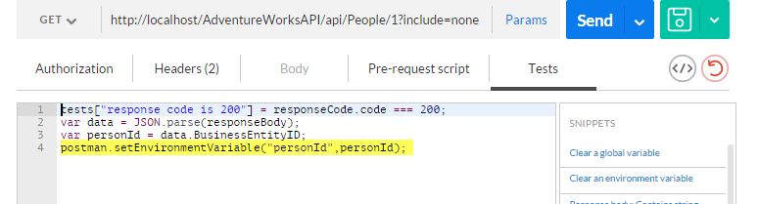
Environment Variables
The Test in the previous slide set an environment variable.

Slide 15
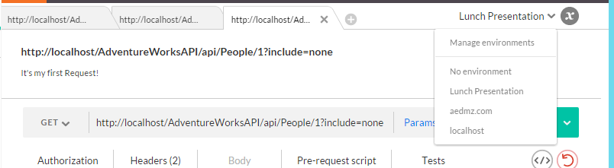
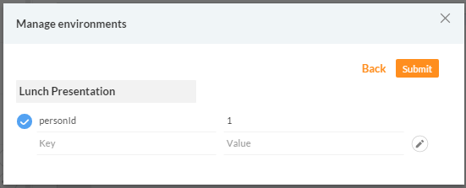
Environment Variables
Demo Environment Variables -- {{variableName}} usage

Slide 16
Demo Test Run

Slide 17
Thank You
Any Questions?

